Slide 1
Redux Pattern
Using redux in your mobile projects

Slide 2

About
Robert Al Malak
Principal Consultant at Neudesic
Coding for more then 15+ years
Enjoys a challenge

Slide 3
Index
What is Redux
State, Store, Action, Reducer, Components
Side Effects
Why Redux ?
Benefits
MVC and redux
MVVM and redux
Provider and redux
Demo
React-Native
Flutter
Pitfalls
Complexity
Large state
What to store

Slide 4
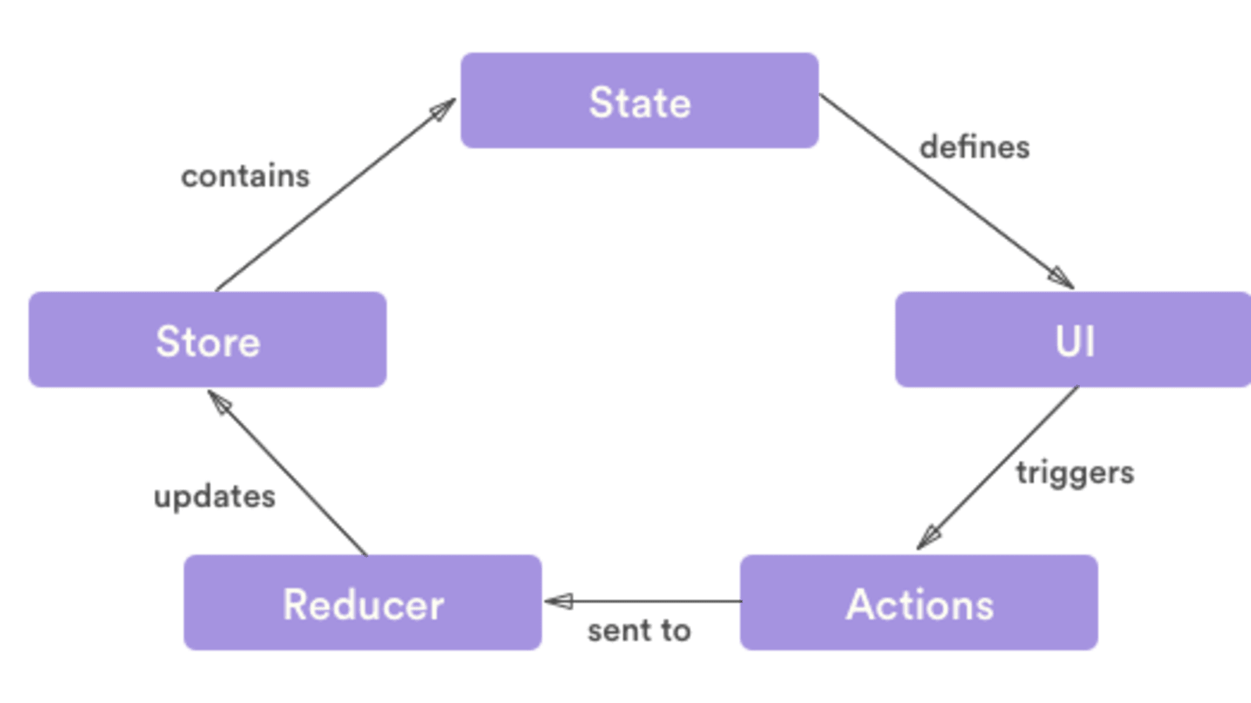
What is Redux

Slide 5
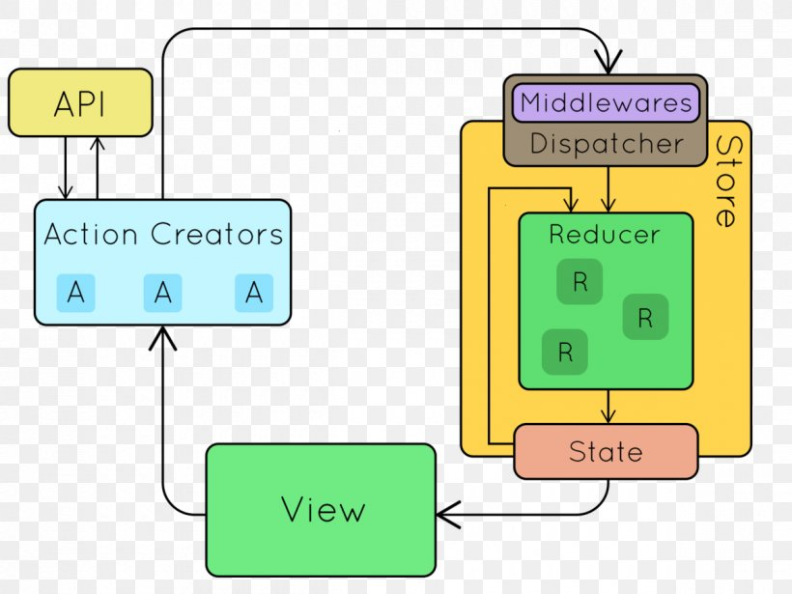

Slide 6
Why Redux?
Global state
Audit trail (using middleware)
Debugging is much easier
Better design
Abstraction
Uni-directional

Slide 7
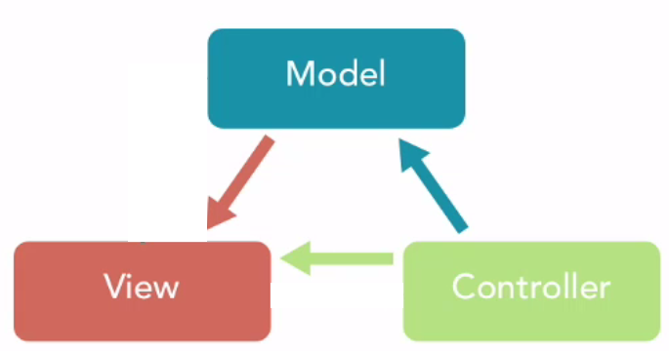
MVC and Redux
Cons:
Massive View Controller
No global state
Omni-directional (spaghetti code)
Pros:
Easier to learn

Slide 8
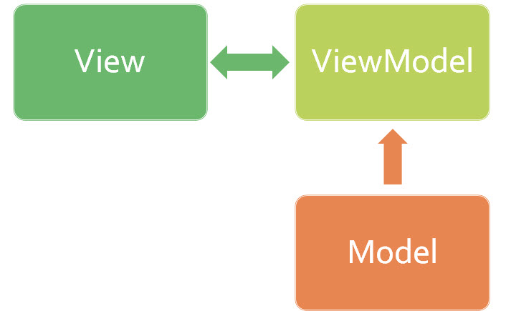
MVVM and Redux
Cons:
No global state
Omni-directional, causing spaghetti code
Pros:
Easier to learn
Bindings

Slide 9
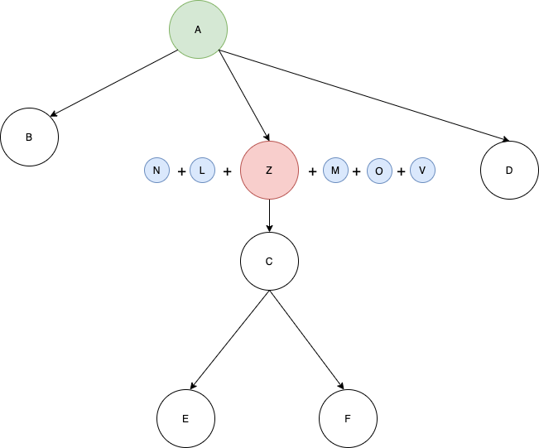
Provider and Redux
Provider pattern can help us push a store to our sub-components.

Slide 10
DEMO
Flutter
React-Native

Slide 11
Pitfalls
Large Global State
Solution: Break them into smaller child states
What to store / Memory footprint
Solution: Careful of what you store, make sure no sensitive data is stored and large objects.
Complexity
Solution: Documentation and education of team
Actions can get messy
Solution: Give clear naming and make default actions that can be reused

Slide 12
Q & A

